Slide 1
Raphael js
Web Engineering Presentation
Ghania Riaz
Maham Shahid

Slide 2

Introduction
Raphael JS is a Javascript library for drawing vector graphics. It supports SVG for latest browsers and VML for older browsers.
It is a cross-platform technology which supports Firefox, Chrome, Opera and Safari.
It is available free for use.
Current version is 2.1.2
Dmitry Baranovskiy

Slide 3
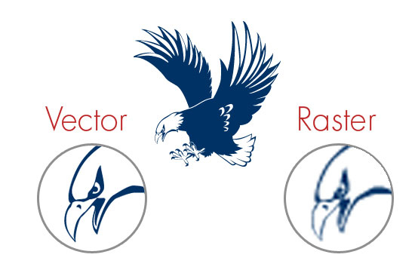
Vector vs Raster
Raster
Raster image is made up of many pixels.
Pixels become blurry when scaled (loss of quality).
HTML Canvas uses raster images.
Vector
Vector image is made up of paths which depend on mathematical calculations (of starting/ending points)
Can be scaled infinitely without losing quality.
SVG uses vector images – so does Raphael JS.

Slide 4


Objective
We can create a variety of useful graphics with Raphael like:
Interactive Maps.
Charts / Diagrams.
Grid of images.
Widgets for use in websites.
Competitors are:
Paper.js
Canvas js
D3.js
Notes:
Paper.js uses canvas technology but supports both raster and vector images…simple and easy-to-understand api canvas.js uses canvas technology as well and supports raster images.It is mainly used for representing data in the form of charts, graphs etc. Efficient graph plotting (fast rendering). D3.js is used for manipulating documents based on data

Slide 5
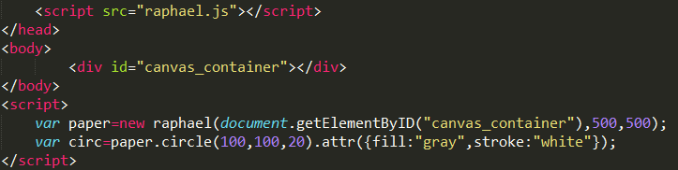
Usage
The library (in zip) can be downloaded from: http://raphaeljs.com
After extracting files, link with raphael.js.
Make a canvas to start drawing into it.
Draw objects, set attributes and animate.

Slide 6
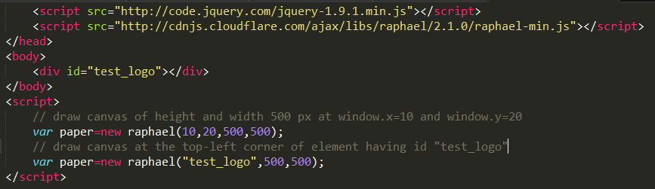
Usage
Linking can be done with cdn as well.
http://cdnjs.cloudflare.com/ajax/libs/raphael/2.1.0/raphael-min.js
We can draw our canvas by specifying co-ordinates.
Another method is to draw the canvas inside some html element. (most common way)

Slide 7
Advantages / Limitations
Advantages:
Thorough Documentation available.
Great browser support (for even older browsers).
All graphics can easily be made responsive.
Limitations:
Difficult to understand for beginners.
Path manipulation gets confusing with complex paths.
Support for only iPhone.
Notes:
> Provides Support till IE6 (because of use of VML technology for rendering on older browsers) > SVG supported on iPhone but not on Android so far.

Slide 8
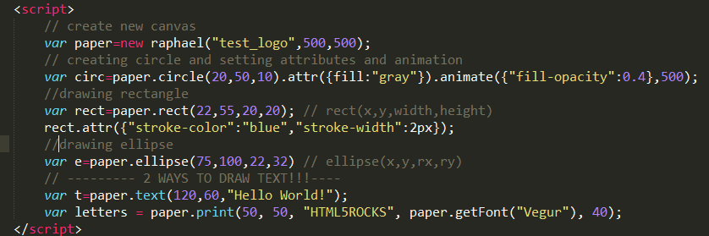
Simple Shapes
We can draw various basic shapes like:
Circles.
Rectangles.
Ellipse.
We can change attributes of and animate these shapes.
Notes:
Include info about examples

Slide 9
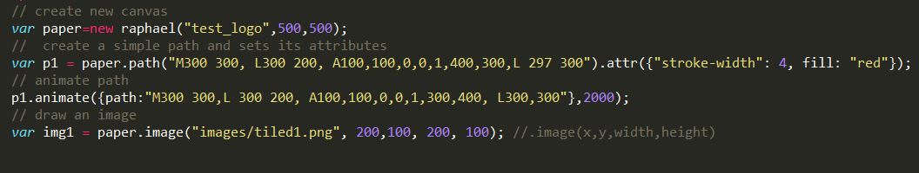
Complex Shapes
We can draw complex shapes as well such as:
Paths.
Images.
Animating complex paths becomes difficult.
Can take code from path tag of .svg directly or make our own path.
SVG to Raphael JS converters are also available for this.
Notes:
A path is an element that describes a set of lines, curves and arcs. A path can be stroked or used as input for other elements.

Slide 10
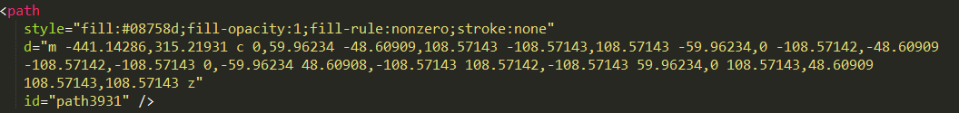
Linking with .svg documents
We can create drawings in any vector graphics program (like inkscape) and import it in Raphael.js
Since .svg is an xml file, we can open it with text editor and copy the path specified under all path tags manually.
Better option is to use a svg-to-raphael converter online. Upload svg file and get code to use in raphael.
Another option is to download and use a parsing program which gives us all paths in a dictionary.

Slide 11
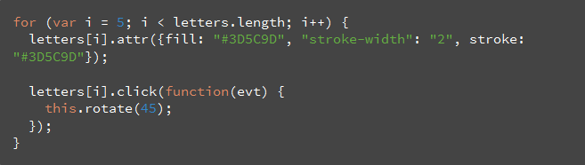
Event Handlers
Everything drawn in Raphael is accessible in the DOM tree.
This means that event handlers can be attached with all our drawings.
Traditional mouse events (click,hover etc) as well as custom events can be added.
Notes:
The snippet below binds a function to rotate a given letter in "ROCKS" 45 degrees when it is clicked.

Slide 12
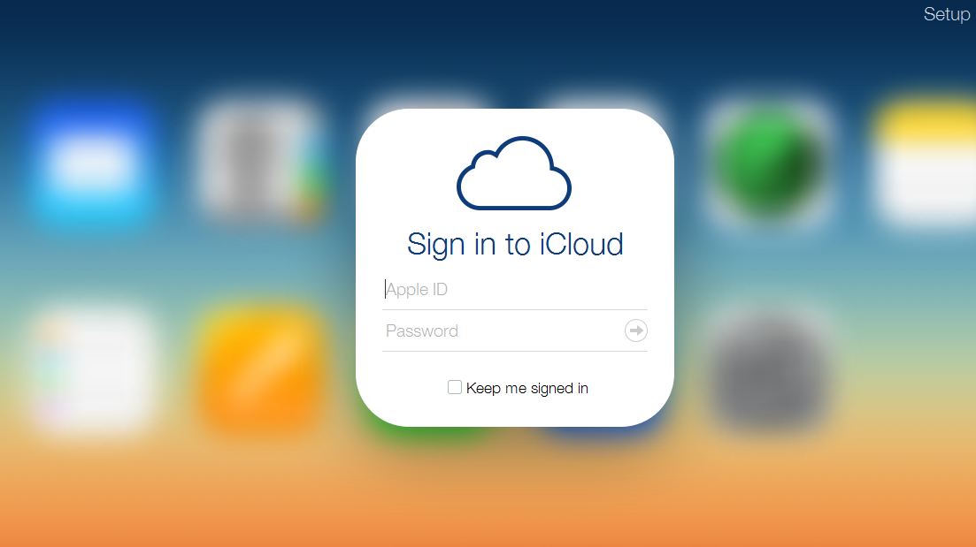
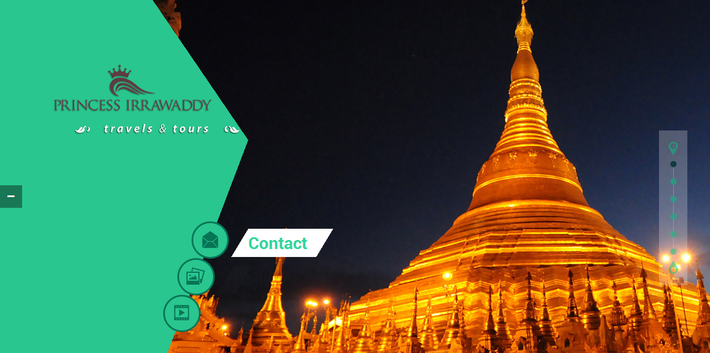
Existing Applications
Some existing websites use this library such as:
iCloud.com
princessirra.com

Slide 13
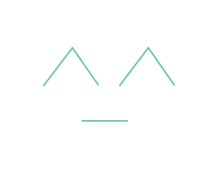
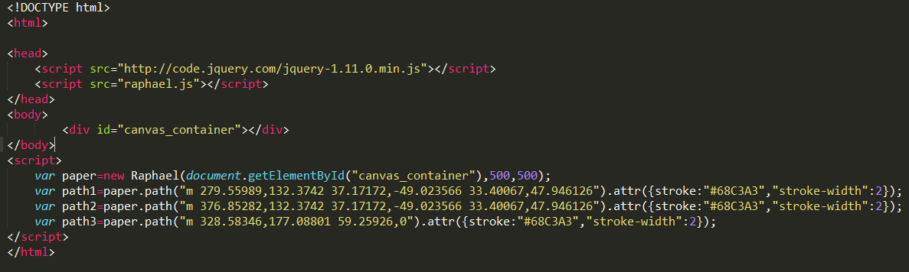
Example
Simple code to make ^_^ emoticon
Output ->
Notes:
In paths: M is for move, A is for arc, L is for line. Q for bezier curves, Q uses absolute co-ordinates and q uses relative to starting point. C for cubic bezier curves.

Slide 14
Demo
Demo App…

